Slide 2
Session 1
Deep Learning Fundamentals (2 hours)
What is Deep Learning?
Difference between ML and DL
Why DL is powerful (handling unstructured data, scalability)
Neural Networks (NNs):
Structure: Neurons, Layers, Weights, Activation Functions (ReLU, Sigmoid, Tanh)
Feedforward Neural Networks (FNNs)
Backpropagation and Gradient Descent
Introduction to Frameworks:
TensorFlow vs PyTorch (Overview, Key Differences)
Practical Exercise (1 hour):
Task: Build a basic neural network using TensorFlow or PyTorch to classify digits from the MNIST dataset.
Key Steps: Load Dataset, Define Neural Network Architecture, Train, Test, and Evaluate the Model (accuracy)

Slide 3
Session 2
Convolutional Neural Networks (CNNs) & Other Architectures (2 hours)
Introduction to CNNs: Convolution, Pooling, Fully Connected Layers
Use Cases:
Image Classification
Object Detection
Other Important Architectures:
Recurrent Neural Networks (RNNs),
Long Short-Term Memory (LSTM) for Sequence Data (text, time series)
Generative Adversarial Networks (GANs) for data generation
Training Deep Networks Challenges:
Overfitting, Vanishing Gradient Problem, Dropout
Practical Exercise (1 hour):
Task: Implement a simple CNN for image classification using the CIFAR-10 dataset.
Key Steps: CNN Architecture Design, Training and Evaluation, Visualizing Results

Slide 4
Session 1
Deep Learning Fundamentals (2 hours)
What is Deep Learning?
Difference between ML and DL
Why DL is powerful (handling unstructured data, scalability)
Neural Networks (NNs):
Structure: Neurons, Layers, Weights, Activation Functions (ReLU, Sigmoid, Tanh)
Feedforward Neural Networks (FNNs)
Backpropagation and Gradient Descent
Introduction to Frameworks:
TensorFlow vs PyTorch (Overview, Key Differences)
Practical Exercise (1 hour):
Task: Build a basic neural network using TensorFlow or PyTorch to classify digits from the MNIST dataset.
Key Steps: Load Dataset, Define Neural Network Architecture, Train, Test, and Evaluate the Model (accuracy)

Slide 5
Deep Learning Fundamentals

Slide 6
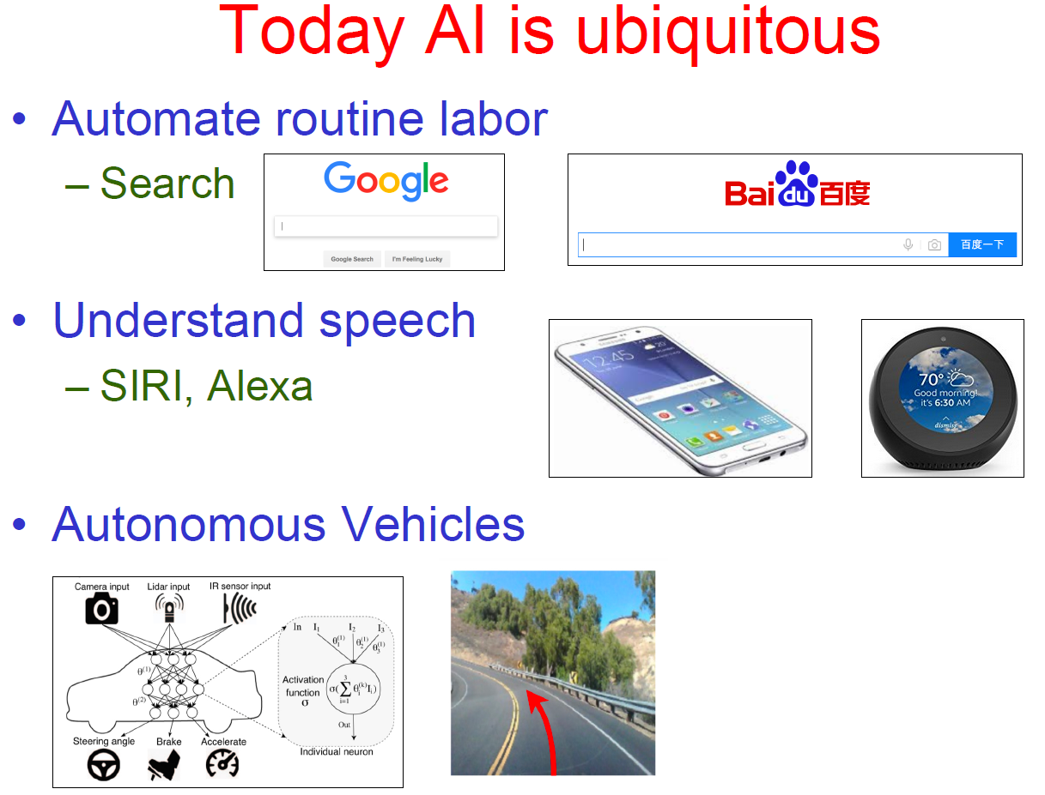
AI = DL = ML ?

Slide 7
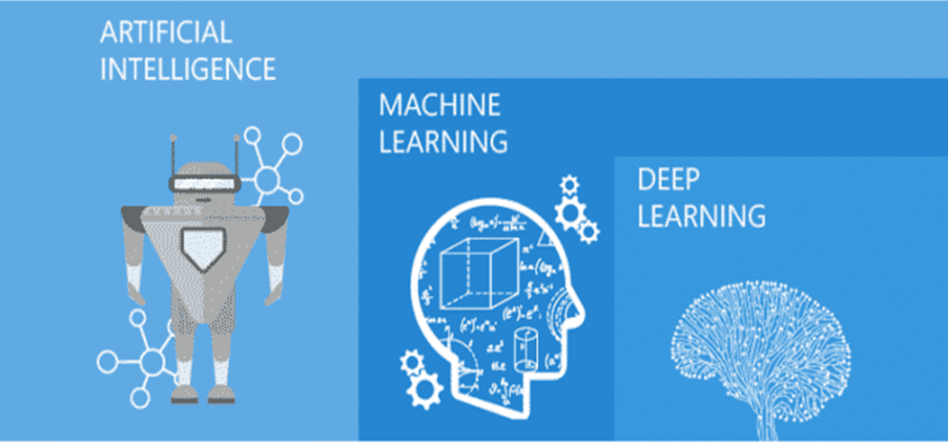
AI = DL = ML ?
AI the big picture, ML emphasize on details, DL more fine details

Slide 8
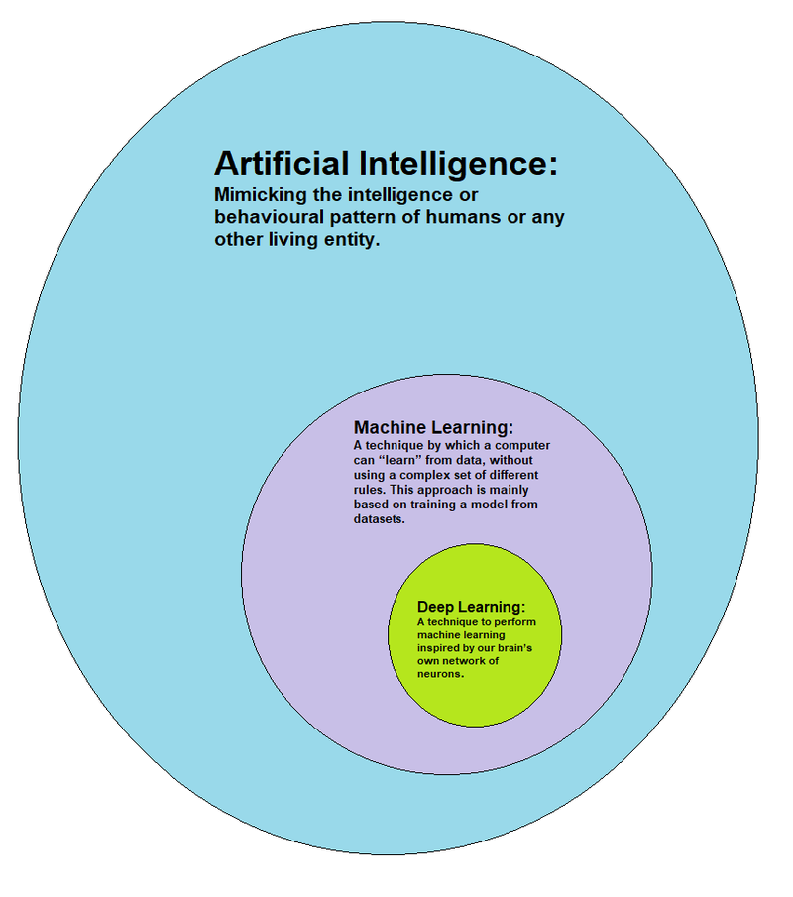
AI = DL = ML ?
AI can be described as the effort to automate intellectual tasks normally performed by humans. AI encompasses ML and DL but also includes many more approaches that may not involve any learning.
Machine Learning techniques automatically learn a model of the relationship between a set of descriptive features and a target feature from a set of historical examples.
DL is a specific subfield of ML: A technique to perform ML inspired by our brain’s own network of neurons. The “deep” refers to successive layers of increasingly meaningful representations.

Slide 9
ML ?
ML enables tackling tasks too difficult to solve with fixed programs, written and designed by human beings
– Scientific and philosophical perspective:
ML is interesting because developing ML entails understanding principles that underlie intelligence
Process of learning itself is not the task
– Learning is our means of attaining ability to perform the task
E.g., if we want a robot to be able to walk, then walking isthe task
We could either program the robot to learn to walk or wecould directly write a program manually for walking

Slide 10
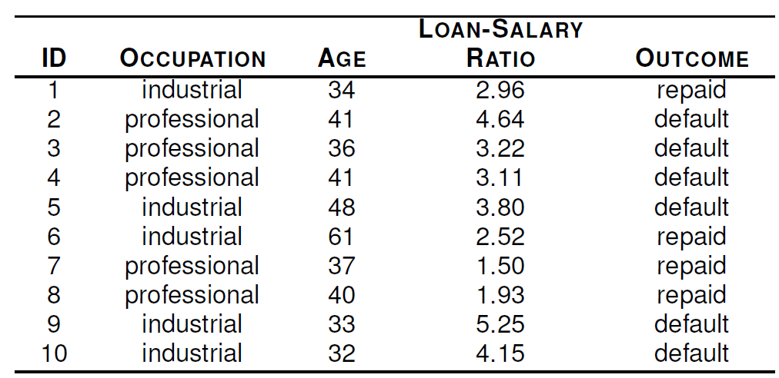
ML ?
What is the relationship between the descriptive features (OCCUPATION, AGE, LOAN-SALARY RATIO) and the target feature (OUTCOME)?
ML algorithms work by searching through a set of possible prediction models for the model that best captures the relationship between the descriptive features
and the target feature.

Slide 11
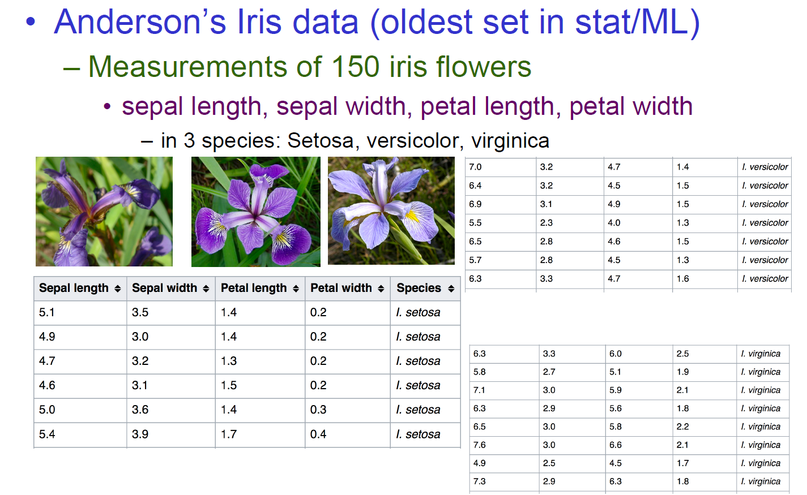
ML?

Slide 12
ML?
Kinds of Tasks solved using ML
1. Classification
2. Classification with missing inputs
3. Regression
4. Transcription
5. Machine Translation
6. Structured Output
7. Anomaly Detection
8. Synthesis and Sampling
9. Imputation of Missing Values
10. Denoising
11. Density Estimation

Slide 13
ML?
Classification models
Logistic regression
Naive Bayes
Decision trees
Random forest
K-nearest neighbor (KNN)
Support vector machine
Regression models
Linear regression
Ridge regression
Decision trees
Random forest
K-nearest neighbor (KNN)
Neural network regression

Slide 14
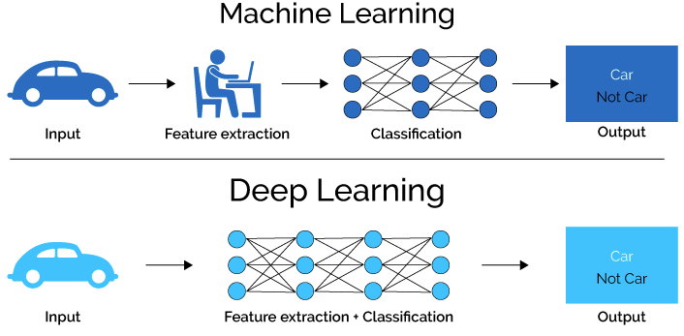
DL ?
ML -> Features are created manually
DL -> Features are generated through training

Slide 15
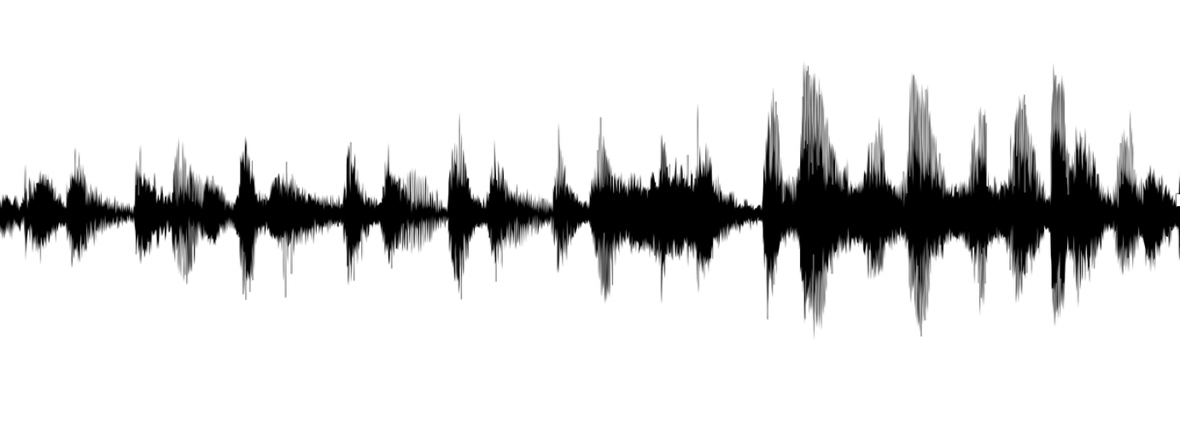
Why DL is powerful? (handling unstructured data, scalability)
Structured Data
Unstructured Data
Size | #bedrooms | … | Price (1000$s)
2104 1600 2400 ⋮ 3000 | 3 3 3 ⋮ 4 |  | 400 330 369 ⋮ 540
Audio
Image
User Age | Ad Id | … | Click
41 80 18 ⋮ 27 | 93242 93287 87312 ⋮ 71244 |  | 1 0 1 ⋮ 1

Slide 16
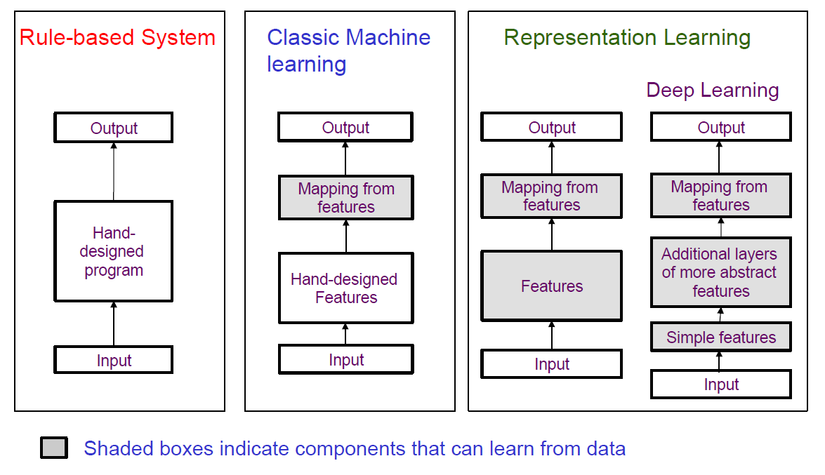
Summary of AI models

Slide 17
Neural Networks(NN)

Slide 18
Convolutional Neural Network (CNN)

Slide 19
Why CNN?
Many possible outcome
Not hard and fast rules
Many dependencies
Complex dependencies

Slide 20
Why CNN?
Many Aspects –
Image Recognition
Image Classification
Object Detection
Face Recognition
And much more
More Accuracy
Lesser Work
Automated Feature Extraction
Faster Learning Rate

Slide 21
Structure of CNN
INPUT LAYER
3 layers
HIDDEN LAYER
OUTPUT LAYER

Slide 22
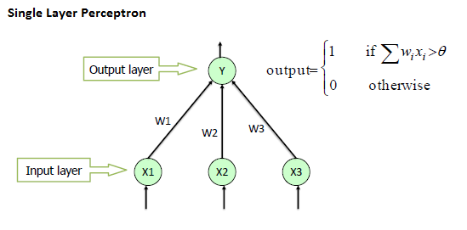
Structure of CNN
Perceptron -> most basic Neural Network
contains – input layer & output layer

Slide 23
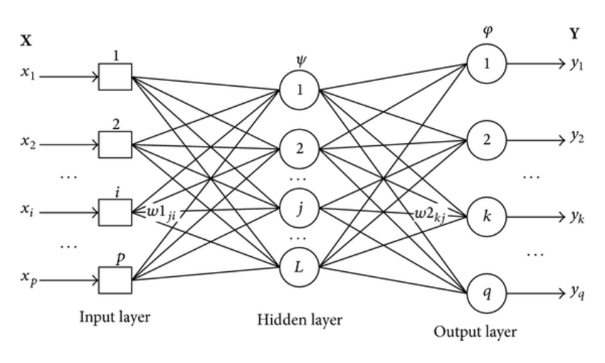
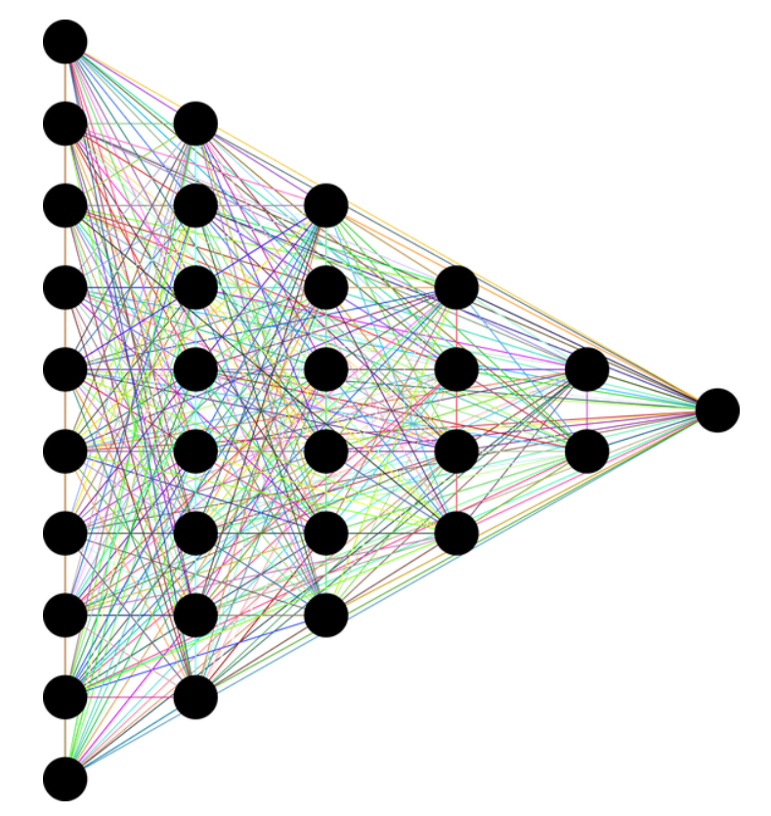
Structure of CNN
CNN - cluster of perceptron with one or more hidden layers

Slide 24
Structure of CNN
INPUT LAYER
CONVOLUTION LAYER
POOLING LAYER
FULLY CONNECTED LAYER
OUTPUT LAYER
5 Layers

Slide 25
Structure of CNN (Cont.)
Input layer: takes input
Convolution layer: filtering/masking to create feature vector
Pooling layer: reduce feature vector
Fully connected layer: takes input from all nodes of previous layer
Output layer: gives the desired output

Slide 26
Convolution
Hover a square matrix over the original matrix
Change the values
Usually the square matrix is called mask/filter
Usually traversal is done for every pixel
Escaping pixel is also possible
Stride = 2; means escape 2 pixel

Slide 27

Convolution (Cont.)
Here is an graphical representation of convolution

Slide 28
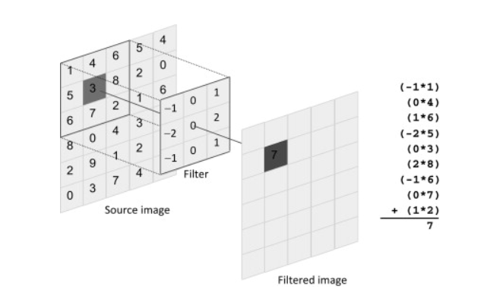

Convolution(Cont.)
Example with values

Slide 29
Pooling
Reducing feature vector
Mainly of two types –
Average pooling
Maximum pooling/ maxpooling
Create a matrix from the original by either taking average or maximum value

Slide 30

Pooling (Cont.)
Examples

Slide 31
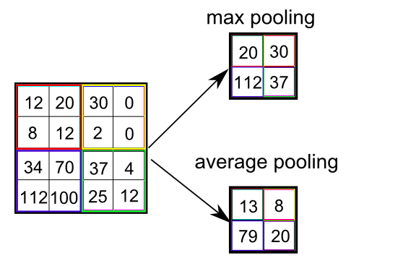
Pooling (Cont.)
Examples

Slide 32
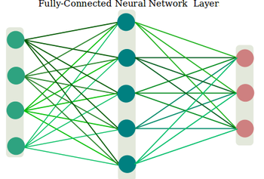
Fully connected layer
Neurons of this layer are connected with all the neurons of the previous layer output
Flatten the features
Turn it into a single vector to pass it to next layer

Slide 33
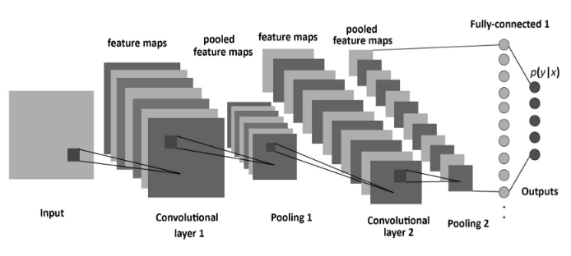
Structure of CNN (Cont.)
So this is how a CNN looks like

Slide 34
CNN Architecture
There have been many CNN architectures
Some of those are –
LeNet-5 – Yann LeChun et al. – 1988
AlexNet – Alex Krizhevsky – 2012
VGG-16 – Christian Szegedy et al. – 2014
Inception-V3 – Christian Szegedy et al. – 2015
ResNet-50 – Kaiming He etal. - 2015

Slide 35
CNN Training
Input Data
Learning
Modeling

Slide 36
CNN Testing
Measure Performance
Test Dataset
ACCURACY
ERROR

Slide 37
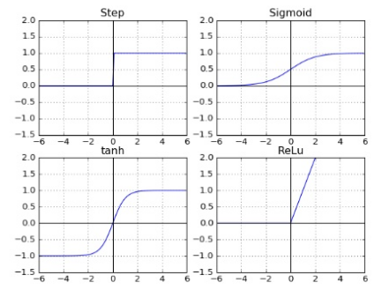
Some Terminology
Activation Function
Step
Sigmoid
Tanh
ReLU
Feature Map
Pre-Processing
Normalization

Slide 38
Activation Functions
Activation functions defines the output of a node
Different type of activation functions
Linear activation functions
Non-linear activation functions

Slide 39
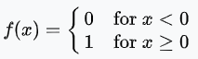
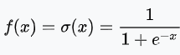
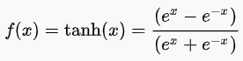
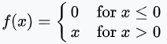
Activation Functions
Step / Binary step function:
Sigmoid / Logistic / Soft step function:
Tanh function:
ReLU (Rectified Linear Unit) function:

Slide 40
Drawbacks
Huge Data
Powerful GPU & CPU
Training Time

Slide 41
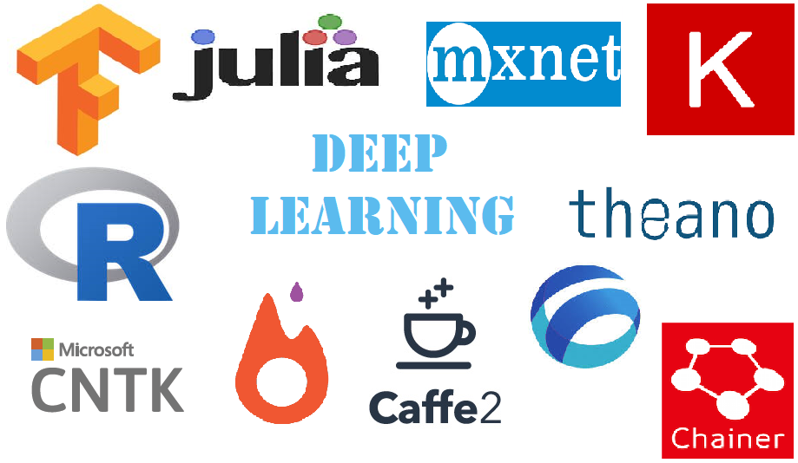
Deep learning frameworks
To ease learning and using deep learning, there are many frameworks
TensorFlow
Keras
PyTorch
Sonnet
MXNet ... etc

